Slide 1
THEVENIN’S THEOREM
Dr. T.YUVAPRIYA
ASSISTANT PROFESSOR
SELECT

Slide 2
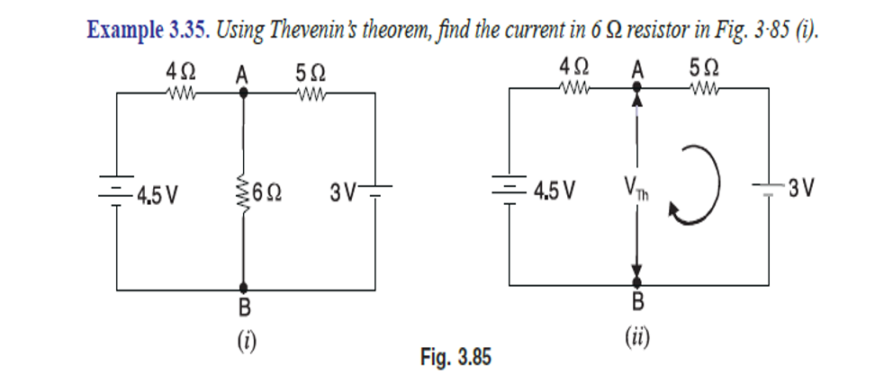

Slide 3



Slide 4
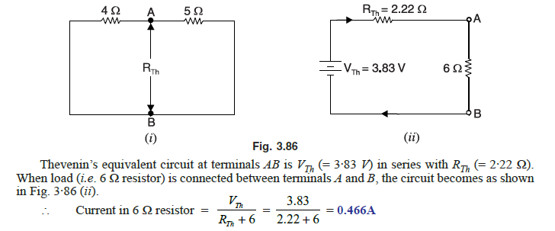

Slide 5

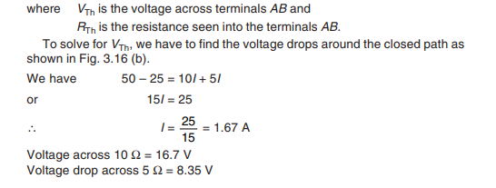

Slide 6
